Slide 1
Exotic Car Rentals
Dino Cajic and Caroline

Slide 2

Requirements
Create an Online Virtual Agent that specializes in one of the following
Travel Booking
Book Flights
Car Rental
Parking Pre-Pay

Slide 3
Projects
Created a Car Rental Online Experience
Utilized the following
PHP
MySQL
Bootstrap
CodeIgniter MVC Framework
jQuery

Slide 4
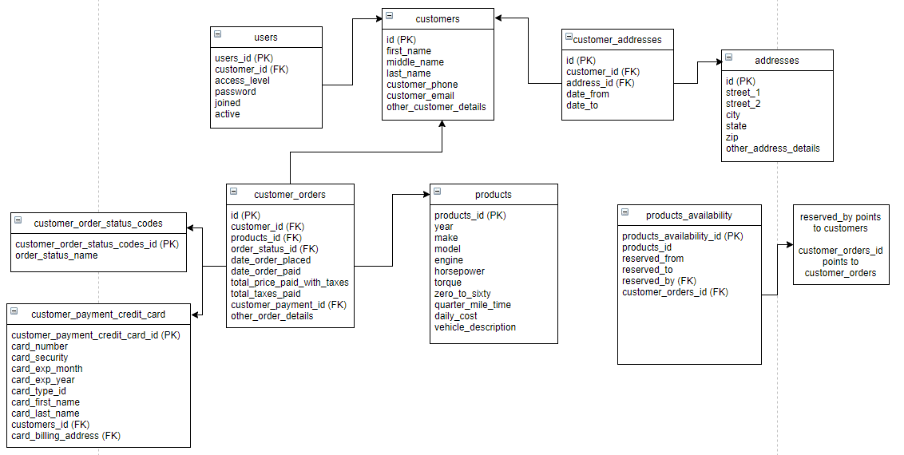
Example Database Schema
DATABASE SCHEMA

Slide 5
Models
Models
cart_model.php
customer_model.php
login_model.php
products_model.php
validation_model.php

Slide 6
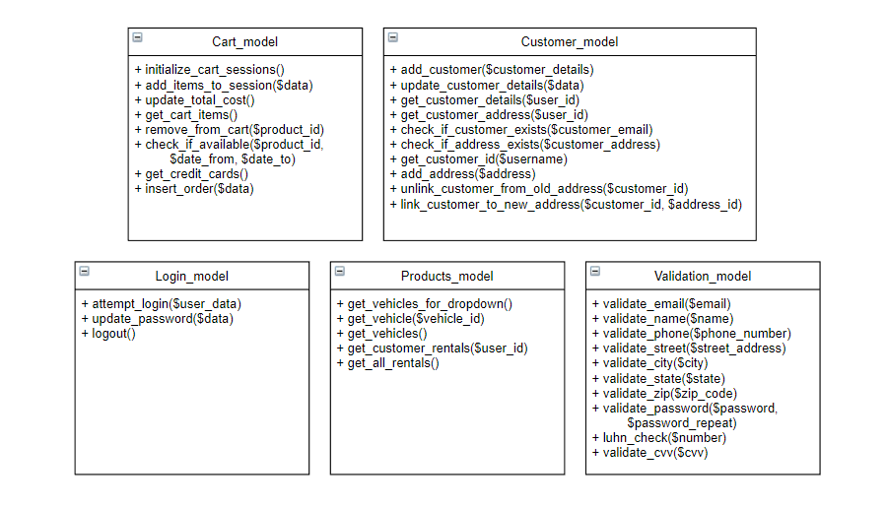
Example Database Schema
DATABASE SCHEMA

Slide 7
Views
Views
about_view.php
admin_account_view.php
cart_view.php
checkout_view.php
checkout_view_success.php
contact_view.php
customer_account_view.php
footer.php
header.php
Views
login_page_view.php
login_view.php
main_view.php
register_view.php
rent_vehicle_view.php
update_profile_view.php
vehicles_to_rent_view.php
view_rental_history_view.php
view_sales_history_view.php

Slide 8
Controllers
Controllers
about.php
admin_account.php
cart.php
checkout.php
contact.php
customer_account.php
login.php
main.php
register.php
rent_vehicle.php
update_profile.php

Slide 9
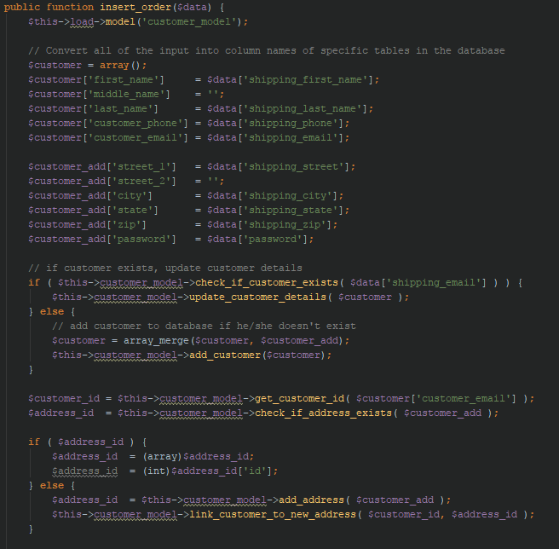
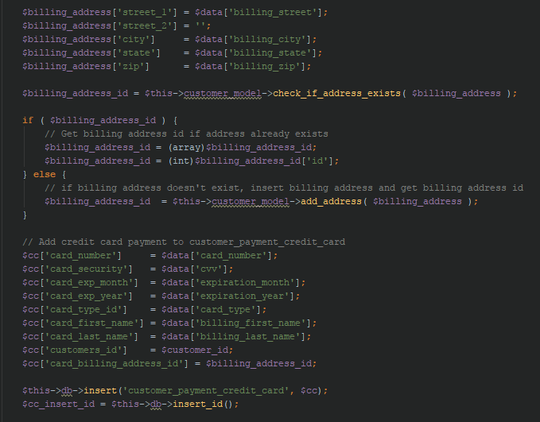
Code: Cart_model->insert_order()

Slide 10
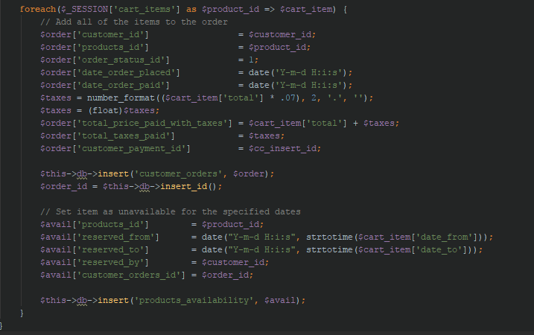
Code: Cart_model->insert_order()

Slide 11
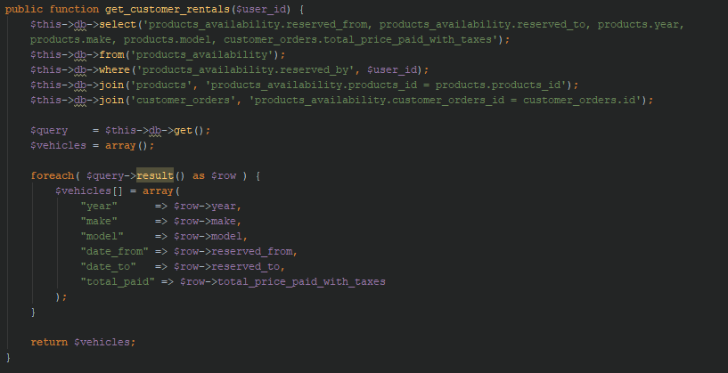
Code: Products_model->get_customer_rentals()

Slide 12
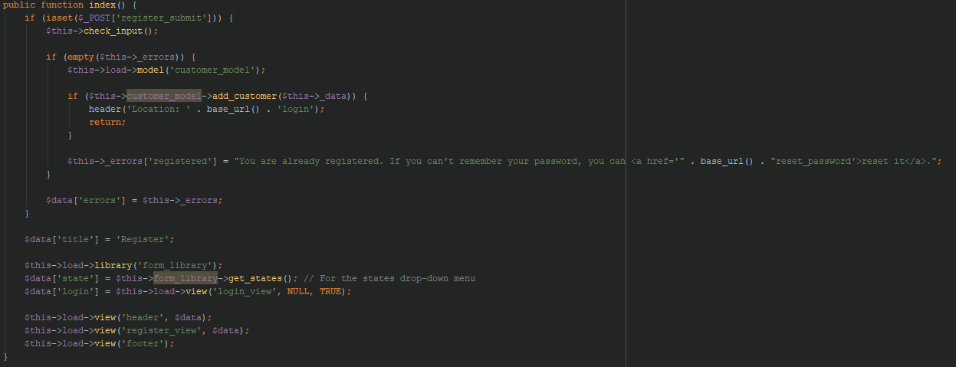
Code: register->index()

Slide 13
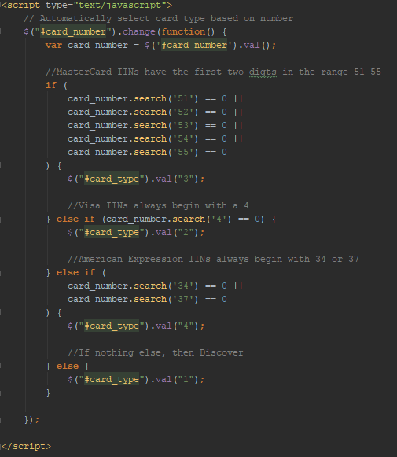
Automatically Select CC

Slide 14
Testing
Tested in Chrome, FireFox and Edge browsers
Tested in localhost environment

Slide 15
Difficulties
Creating a manageable database schema
Creating an e-commerce website in such a short amount of time

Slide 16
Project Info
Total Time Spent: 30 hours
Programming Methodology: Extreme Programming
Total Lines of Code (PHP): 1599
Total Lines of Code (HTML): 1149
Total Lines of Code (CSS): 585
Total Lines of Code (Total): 3333

